Slide 1
Incorporating digital forensics capability into Our access Portfolio
Team Members:
Vignesh Balakrishnan
Manish Jaiswal
Michael Rennie
Ranjeet Mani
Team Name : Cyber Knights
CATEGORY : Remote Access & Management
Location : Bangalore
Date : 13th Oct, 2017

Slide 2



The Problem
Multiple products for IT infrastructure management and Endpoint Security

Slide 3
Market size
711mn devices
40mn devices
$2.28bn by 2021
CAGR of 25%
$749mn in 2016
**Reports based on Gartner and PRNewswire

Slide 4
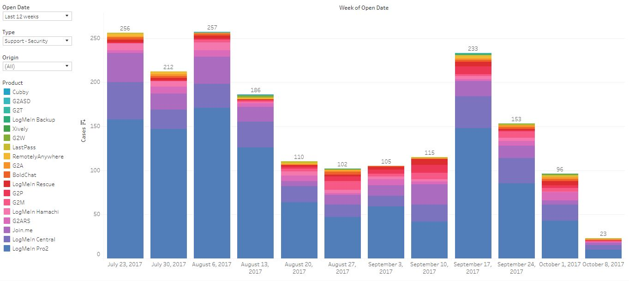
Customer Validation Data points from our customer care team for incidents related to security

Slide 5
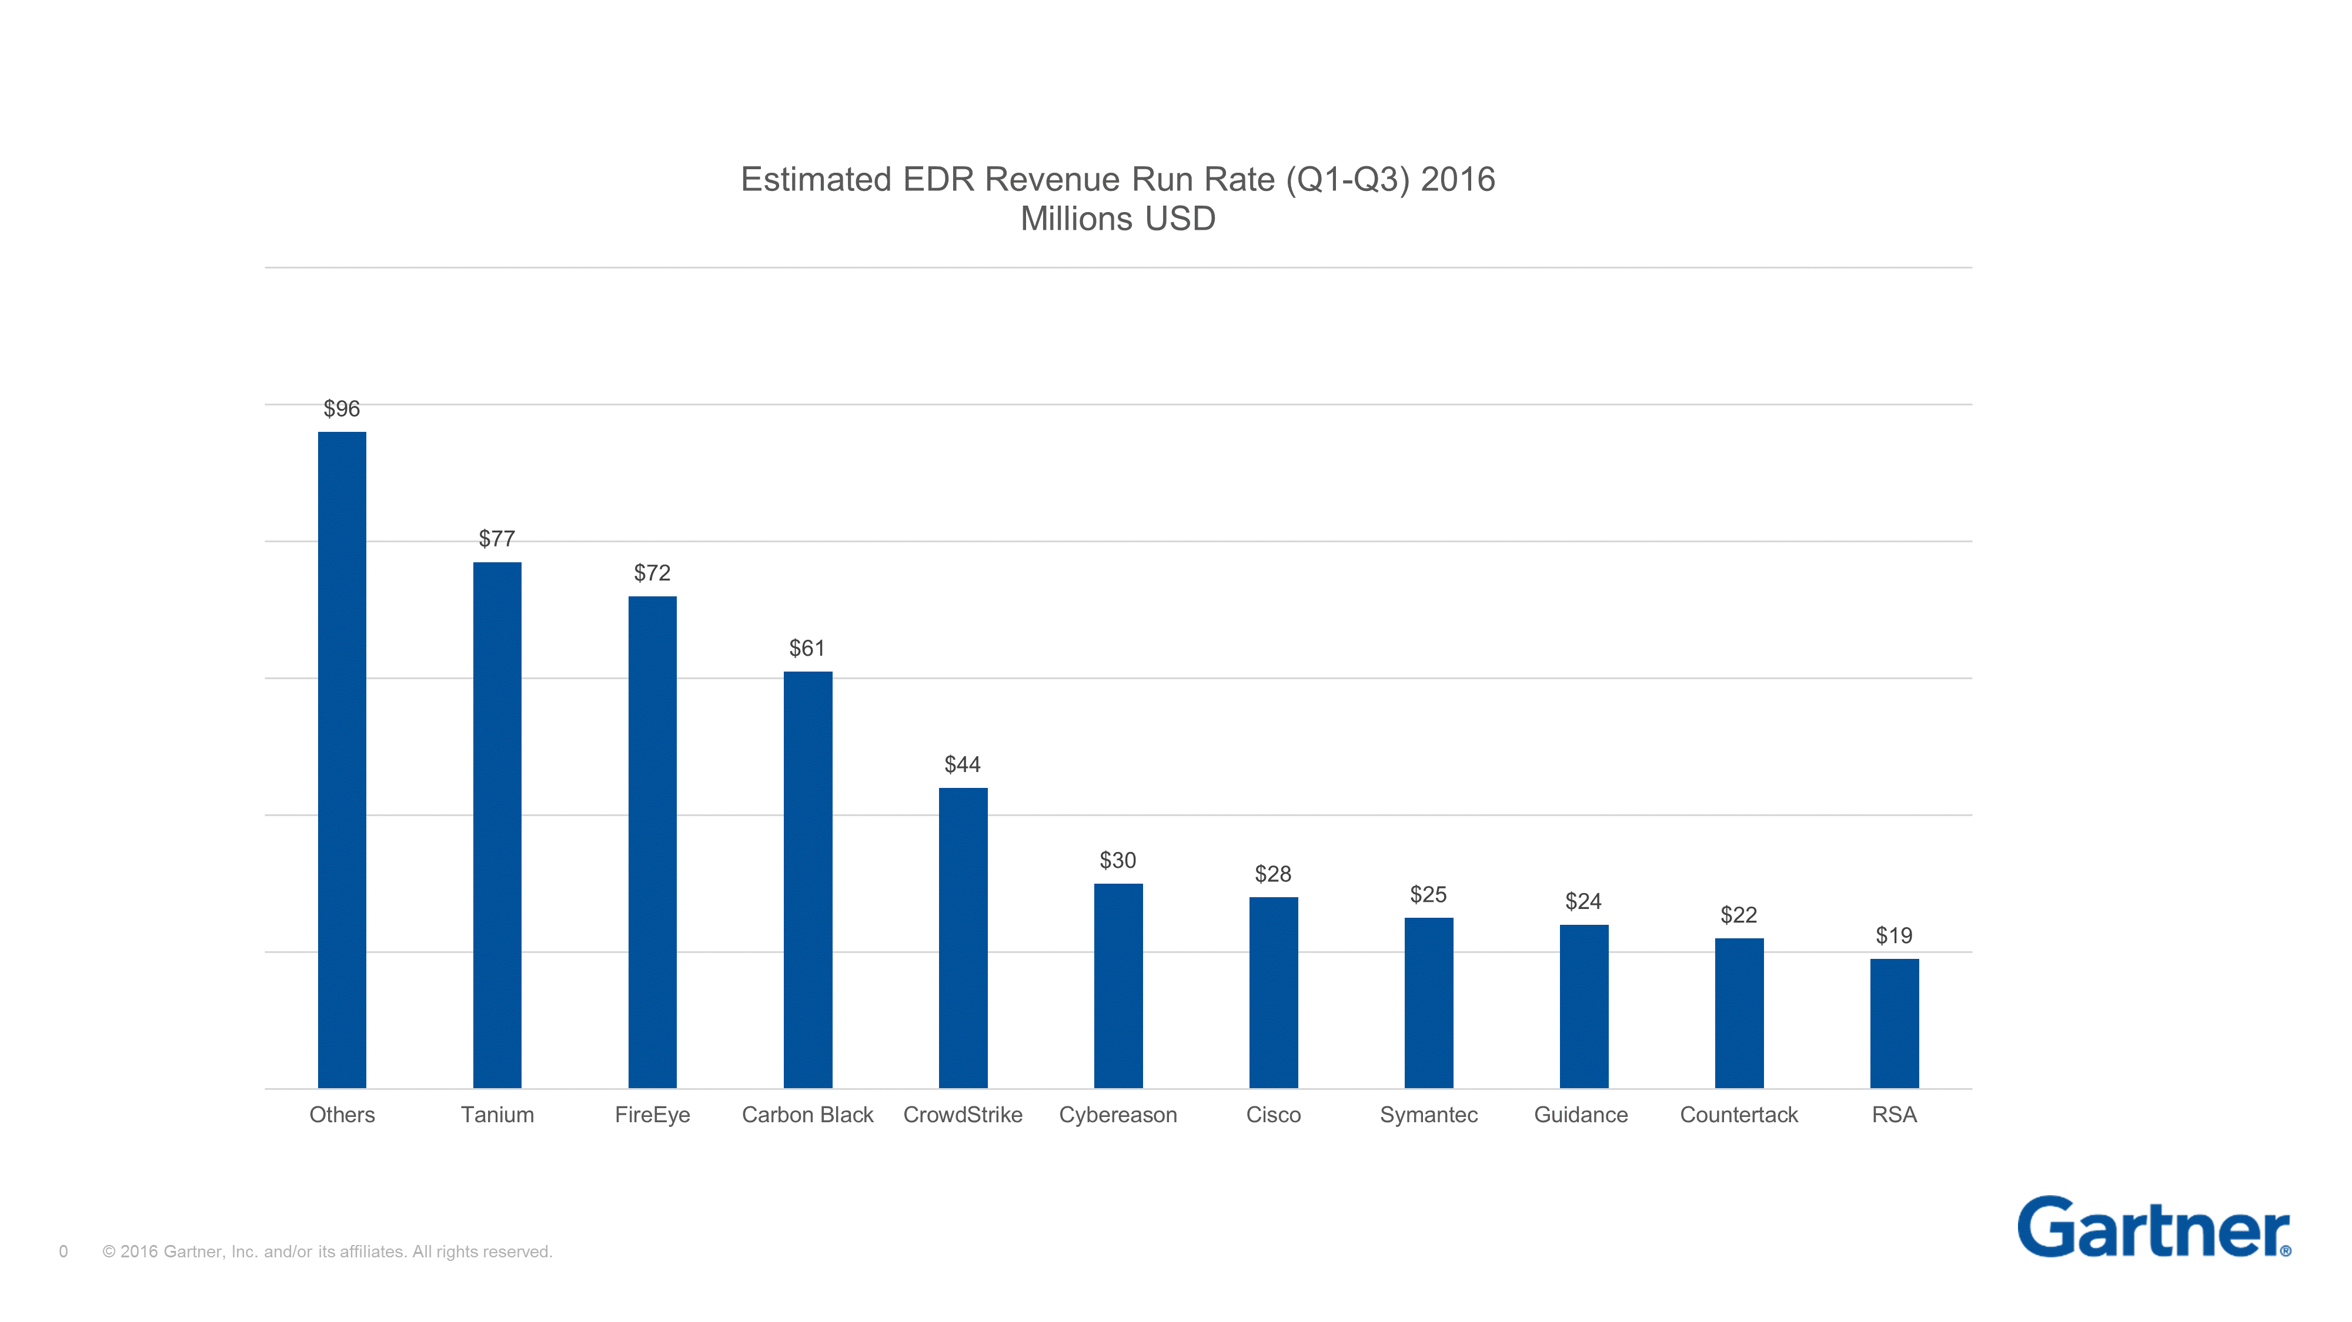
Competitor landscape

Slide 6



The Solution/Benefit to Customers
An online tool, integrated with CentralPro/Rescue for users to gain fast, in-depth visibility into their network
Reducing the need for multiple security software
Single agent monitoring
Respond to alerts, identify & analyze

Slide 7
Competitive advantage
Bundled packaging
Reduced expenditure
Reduced manual process and controls

Slide 8
Product DEMO…

Slide 9
OUR BUSINESS MODEL – THANK YOU!!!
PROBLEM | SOLUTION | UNIQUE VALUE PROPOSITION | UNFAIR ADVANTAGE | CUSTOMER SEGMENTS
Multiple products for IT infrastructure management with a lack of Endpoint Security focus results in Increase in cost Operational overhead Complex solutions requires skilled resource | Integrate basic Endpoint Detection and Response [EDR] capability into our Access Portfolio Single agent Simplify detection and response Mitigate possible risk and adhere compliance | Single Product with centralized view to manage IT infrastructure and equip security teams/ IT admins with Endpoint detection, analysis and response capabilities | An integrated solution that supports the needs of multiple stakeholders (IT, Security Team, Customer Care) | Organizations who do not have a dedicated security team Security Operations and IT infrastructure team SMB who need simple, effective and cost efficient solution
EXISTING ALTERNATIVES | KEY METRICS | HIGH LEVEL CONCEPT | CHANNELS | EARLY ADOPTERS
Expensive Commercial EDR Products [ FireEye, Carbon Black, Tanium , Crowd Strike, etc.] | No of agents deployed Revenue per customer | --NA-- | Marketing and Advertisement Webinars and Conference | Existing CentralPro and Rescue Customers
COST STRUCTURE | REVENUE STREAMS
Resources to research and develop Endpoint Detection and Response [EDR] capability Hosting infrastructure Acquisition cost | Agent based licensing per endpoint Subscription model

Slide 10
Appendix
https://india.emc.com/security/rsa-ecat.htm#!resources - resources
https://india.emc.com/collateral/analyst-reports/esg-rethinking-endpoint-security.pdf - report ESG
https://india.emc.com/collateral/customer-profiles/h11832-emc-ecat-cp.pdf - RSA use-case
http://blogs.gartner.com/avivah-litan/2017/03/15/morphing-edr-market-grows-to-1-5-billion-in-2020/ - growth
https://www.sans.org/reading-room/whitepapers/analyst/security-spending-trends-36697 - expenses
http://www.prnewswire.com/news-releases/endpoint-detection-and-response-edr-market-to-grow-at-a-cagr-of-25-by-2021-increasing-instances-of-enterprise-endpoint-targeted-attacks---research-and-markets-300405030.html - prnewswire

Slide 11
Appendix(Contd) DIFFERENCE BETWEEN current CENTRALPRO FEATURES vs PROPOSED ONE
CURRENT
PROPOSED
Patch Management
Anti virus Protection
Anti Malware Protection
Proactive Alerts
End Point Monitoring
Audit & Inventory
Mobile Access
Complete Endpoint visibility
Evidence of execution
Persistence Mechanism
Lateral Movement
Gather Forensic Evidence
Search across network for Indicators of Compromise (IoC)
Browser Artifacts
Overview of System

